Slide 1
11. Natural Language Processing with ML: similarity and embeddings
IT 348/448

Slide 2
Topics
Cosine similarity
Td*idf
Embeddings

Slide 3
Examples
I go to the bank
I go to the bank to deposit $50
I go to the bank to see the river.
Stop words
To, the, a, an, on, the, into

Slide 4
Distributional Hypothesis
Words that occur in similar contexts tend to have similar meanings.
This link between similarity in how words are distributed and similarity in what they mean is called the “distributional hypothesis.”
The hypothesis was first formulated in the 1950s by linguists like Joos (1950), Harris (1954), and Firth (1957)

Slide 5
What do words mean?
N-gram or text classification methods we've seen so far
Words are just strings (or indices w_{i} in a vocabulary list)
This does not consider semantics

Slide 6
Words, Lemmas, Senses, Definitions
lemma
sense
definition

Slide 7
Lemma “Pepper”
Sense 1: spice from pepper plant
Sense 2: the pepper plant itself
Sense 3: another similar plant (Jamaican pepper)
Sense 4: another plant with peppercorns (California pepper)
Sense 5: capsicum (i.e. chili, paprika, bell pepper, etc)

Slide 8
Lemmas and senses
lemma
mouse (N) 1. any of numerous small rodents... 2. a hand-operated device that controls a cursor...
sense
A sense or “concept” is the meaning component of a word
Lemmas can be polysemous (have multiple senses)

Slide 9
Relations between senses: Synonymy
Synonyms have the same meaning in some or all contexts.
filbert / hazelnut
couch / sofa
big / large
automobile / car
vomit / throw up

Slide 10
Relation: Antonymy
Senses that are opposites with respect to one feature of meaning
Examples:
dark/light short/long
fast/slow rise/fall
hot/cold up/down
in/out

Slide 11
Relation: Similarity
Words with similar meanings. Not synonyms, but sharing some element of meaning
Examples:
car, bicycle
cow, horse

Slide 12
Relation: Similarity
While words don’t have many synonyms, most words do have lots of similar words.
Cat is not a synonym of dog, but cats and dogs are certainly similar words.
The notion of word similarity is very useful in larger semantic tasks.
Knowing how similar two words are can help in computing how similar the meaning of two phrases or sentences are.
a very important component of natural language understanding tasks like question answering, paraphrasing, and summarization.

Slide 13
Relation: Word relatedness
Also called "word association"
Words are related in any way, perhaps via a semantic frame or field
Examples
car, bicycle: similar
car, gasoline: related, not similar

Slide 14
Semantic field
One common kind of relatedness between words is if they belong to the same semantic field.
A semantic field
is a set of words which cover a particular semantic domain and bear structured relations with each other.

Slide 15
Semantic field
Words that
cover a particular semantic domain
bear structured relations with each other.
Examples:
Hospitals: surgeon, scalpel, nurse, anaesthetic, hospital
restaurants: waiter, menu, plate, food, menu, chef
Houses: door, roof, kitchen, family, bed

Slide 16
Connotation (sentiment)
The aspects of a word’s meaning that are related to a writer or reader’s emotions, sentiment, opinions, or evaluations
Words have affective meanings
Positive connotations (happy)
Negative connotations (sad)

Slide 17
Connotation (sentiment)
Connotations can be subtle:
Positive connotation: copy, replica, reproduction
Negative connotation: fake, knockoff, forgery
Evaluation (sentiment!)
Positive evaluation (great, love)
Negative evaluation (terrible, hate)

Slide 18
Words and vectors

Slide 19
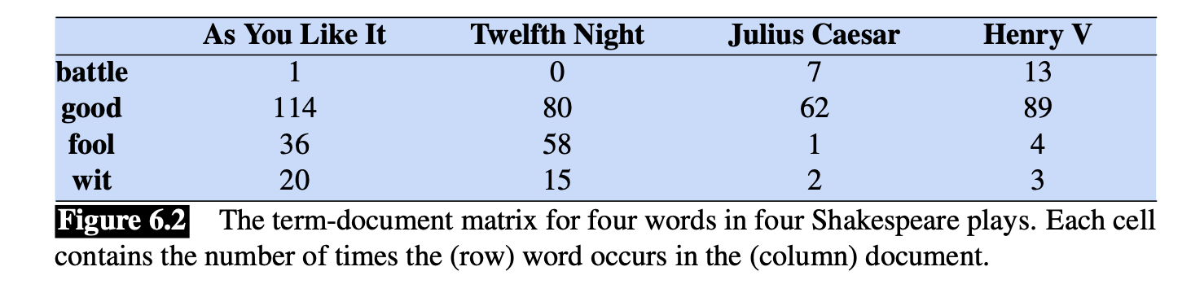
A term-document matrix
In a term-document matrix,
each row represents a word in the vocabulary
each column represents a document from some collection of documents.

Slide 20
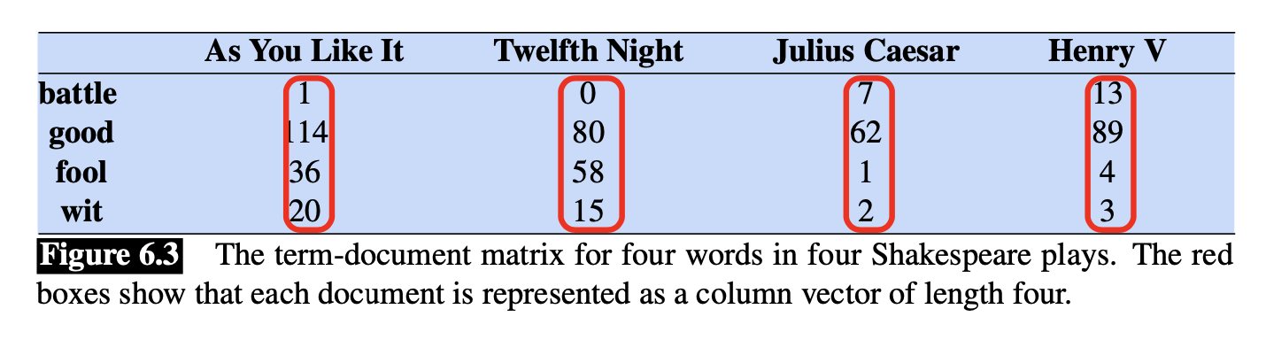
Document representation
A document is represented as a count vector
A document is considered as a point in |V| -dimensional space

Slide 21
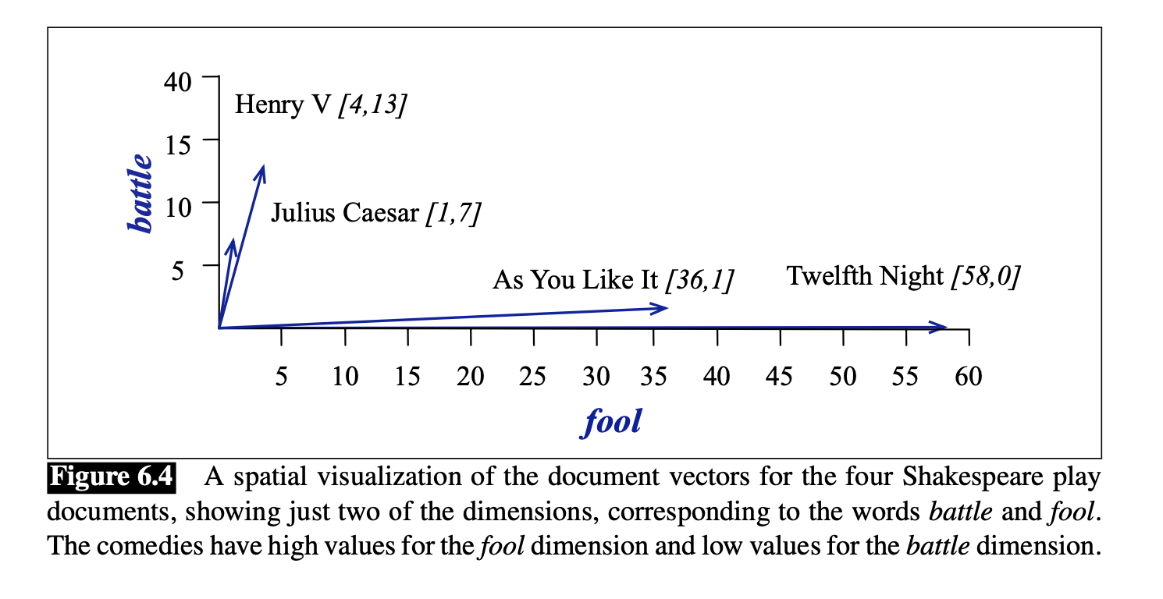
Document similarity

Slide 22
Words as vectors: document dimensions
A documents can be represented as vectors in a vector space.
Vector semantics can also be used to represent the meaning of words.
We do this by associating each word with a word vector— a row vector rather than a column vector,

Slide 23
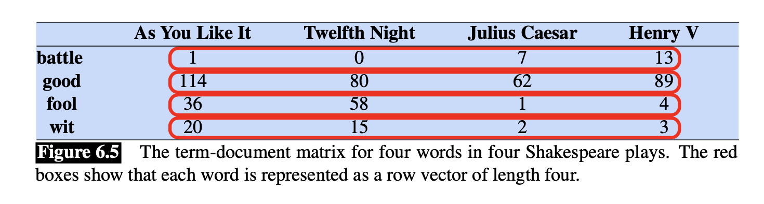
Words as vectors: document dimensions

Slide 24
Introducing vector semantics
For documents, we saw that similar documents had similar vectors since similar documents tend to have similar words,
Similarly,
similar words have similar vectors because they tend to occur in similar documents.
The term-document matrix thus lets us represent the meaning of a word by the documents it tends to occur in.

Slide 25
Words as vectors: word dimensions
Term-term matrix
Also called the word-word matrix or the term-context matrix
This matrix is thus of dimensionality |V | × |V |
Each cell records the number of times the row (target) word and the column (context) word co-occur in some context in some training corpus.

Slide 26
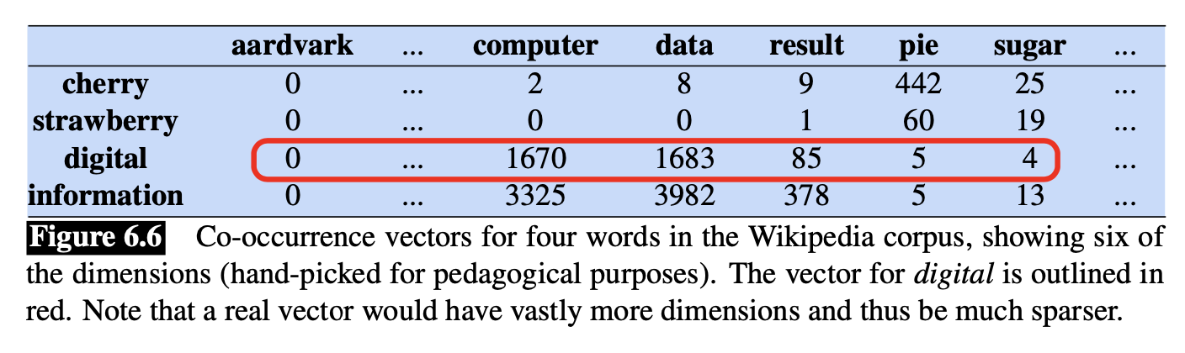
Term-term matrix

Slide 27
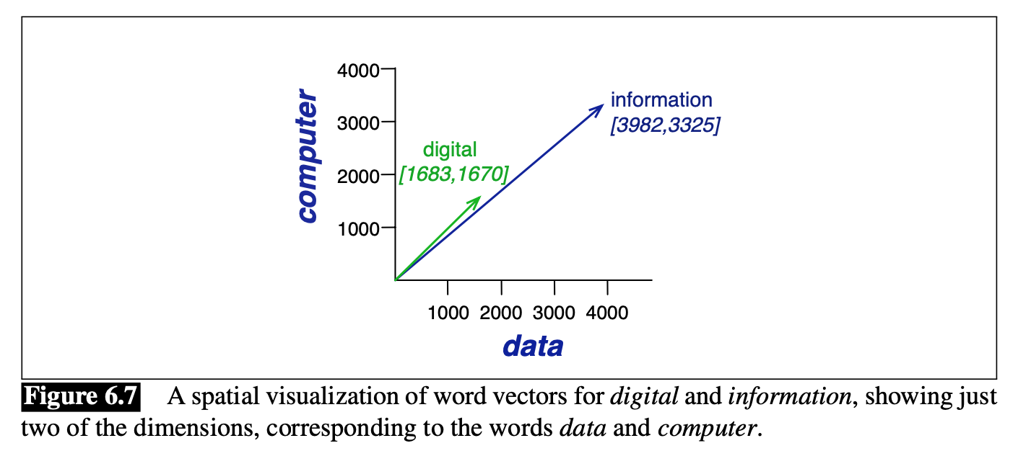
A spatial visualization of word vectors

Slide 28
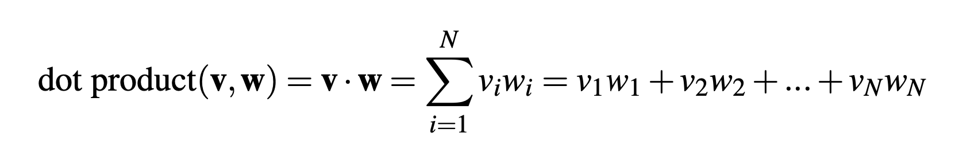
Cosine for measuring similarity
The cosine—like most measures for vector similarity used in NLP
is based on the dot product operator from linear algebra, also called the inner product:
V = (v1, v2, …, vn), W=(w1, w2, …wn)

Slide 29
Issues with dot product
This raw dot product, however, has a problem as a similarity metric:
it favors long vectors. The vector length is defined as the number of elements in the vector
The dot product is higher if a vector is longer, with higher values in each dimension.
The raw dot product thus will be higher for frequent words.

Slide 30
Normalization
We need a similarity metric that tells us how similar two words are regardless of their frequency and length.
A normalized dot product
We modify the raw dot product to normalize the vector length
by dividing the dot product by the lengths of each of the two vectors.

Slide 31
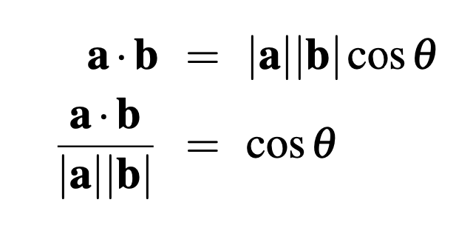
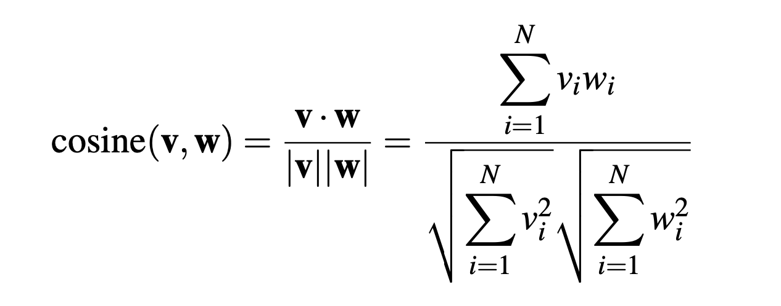
Normalized dot product

Slide 32
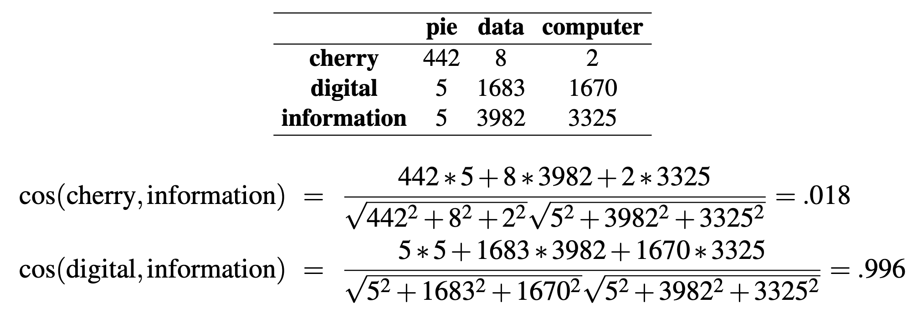
Example

Slide 33
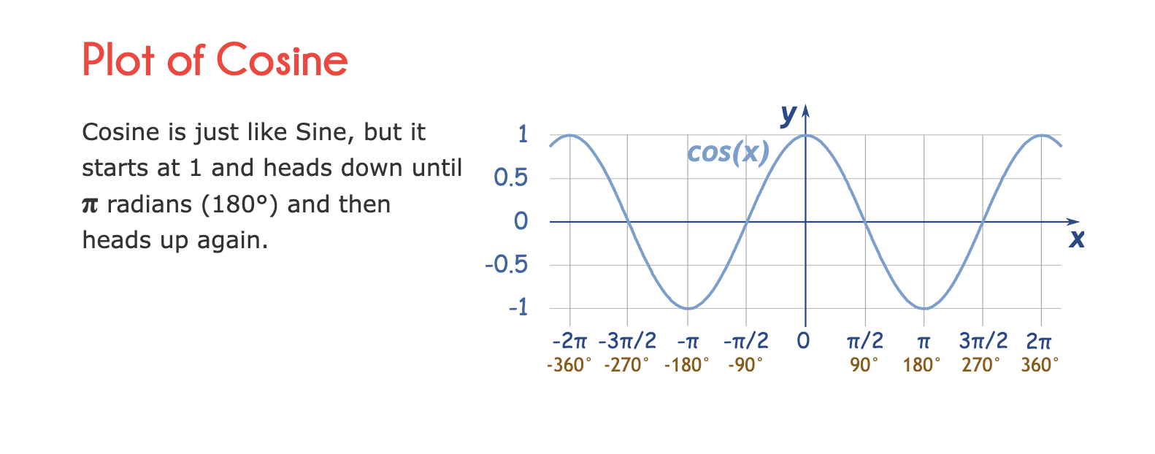
Cosine function

Slide 34

Example

Slide 35
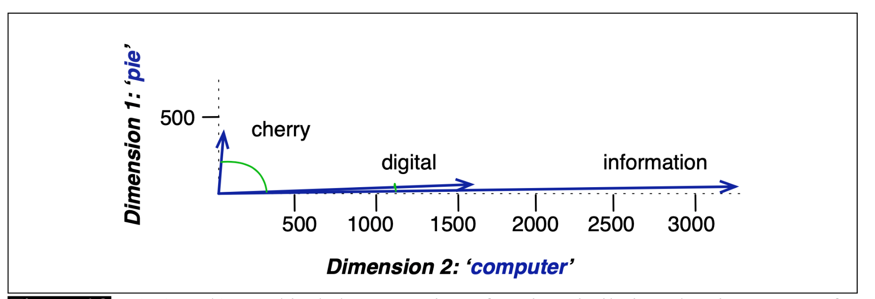
Cosine Similarity (graphical demo)

Slide 36
Tf*idf (Term frequenCy * inverse document frequency)

Slide 37
But raw frequency is a bad representation
The co-occurrence matrices we have seen represent each cell by word frequencies.
Frequency is clearly useful; if sugar appears a lot near apricot, that's useful information.
But overly frequent words like the, it, or they are not very informative about the context
It's a paradox! How can we balance these two conflicting constraints?
Notes:
The co-occurrence matrices we've been using represent each cell by frequencies of words with other words or documents. But raw frequency is is very skewed and not very discriminative. If sugar appears a lot near apricot, that's useful information. But words like the, or it, which occur frequently with all sorts of words, aren’t informative about any particular word . It’s a bit of a paradox. How can we balance these two conflicting constraints?

Slide 38
Tf*idf for word weighting
tf-idf:
The tf-idf algorithm is the product of two terms
TF: the term frequency of the word t in the document d.
IDF: inverse document frequency
tf-idf value for word t in document d:

Slide 39
Term frequency tf
tf_{t,d} = count(t,d)
Raw count
Instead of using raw count, we squash a bit:
tf_{t,d} = log₁₀(count(t,d)+1) ; or

Slide 40
Log-frequency weighting
The log frequency weight of term t in d is
0 → 0, 1 → 1, 2 → 1.3, 10 → 2, 1000 → 4, etc.

Slide 41
Term frequency tf
The term frequency tf_{t,d} of term t in document d is defined as the number of times that t occurs in d.
We want to use tf when computing query-document match scores. But how?
Raw term frequency is not what we want:
A document with 10 occurrences of the term is more relevant than a document with 1 occurrence of the term.
But not 10 times more relevant.
Relevance does not increase proportionally with term frequency.

Slide 42
What is a document?
Could be a play or a Wikipedia article
But for the purposes of tf-idf, documents can be anything; we often call each paragraph a document!

Slide 43
Document frequency … 1
Rare terms are more informative than frequent terms
For example: stop words are very frequent
A, the, is, they
Consider a term in the query that is rare in the collection (e.g., arachnocentric)
A document containing this term is very likely to be relevant to the query arachnocentric
→ We want a high weight for rare terms like arachnocentric.

Slide 44
Document frequency … 2
Frequent terms are less informative than rare terms
Consider a query term that is frequent in the collection (e.g., high, increase, line)
A document containing such a term is more likely to be relevant than a document that doesn’t
But it’s not a sure indicator of relevance.
→ For frequent terms, we want high positive weights for words like high, increase, and line
But lower weights than for rare terms.
We will use document frequency (df) to capture this.

Slide 45
Collection vs. Document frequency
Sec. 6.2.1
The collection frequency of t is the number of occurrences of t in the collection, counting multiple occurrences.
Example:
Which word is a better search term (and should get a higher weight)?
Word | Collection frequency | Document frequency
insurance | 10440 | 3997
try | 10422 | 8760

Slide 46
Document frequency (df)
df_{t} is the number of documents t occurs in.
(note this is not collection frequency: total count across all documents)
"Romeo" is very distinctive for one Shakespeare play:

Slide 47
idf (inverse df) weight
Sec. 6.2.1
df_{t} is the document frequency of t: the number of documents that contain t
df_{t} is an inverse measure of the informativeness of t
df_{t} ≤ N (where N is the number of documents in the given collection or corpus)
We define the idf (inverse document frequency) of t by
We use log (N/df_{t}) instead of N/df_{t} to “dampen” the effect of idf.

Slide 48
Inverse document frequency (idf)
N is the total number of documents
in the collection
In this example, N = 37

Slide 49
tf-idf weighting
Sec. 6.2.2
The tf-idf weight of a term is the product of its tf weight and its idf weight.
Best known weighting scheme in information retrieval
Note: the “-” in tf-idf is a hyphen, not a minus sign!
Alternative names: tf.idf, tf x idf
Increases with the number of occurrences within a document
Increases with the rarity of the term in the collection

Slide 50
The tf-idf weighted value for a word
Raw counts:
tf-idf:

Slide 51
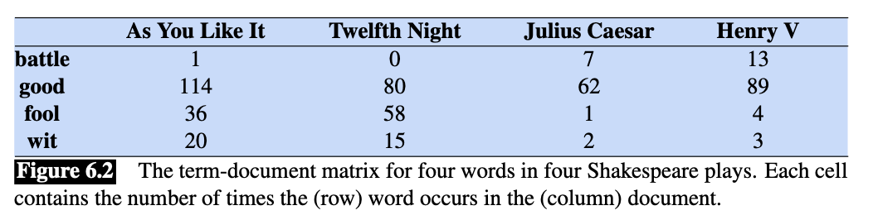
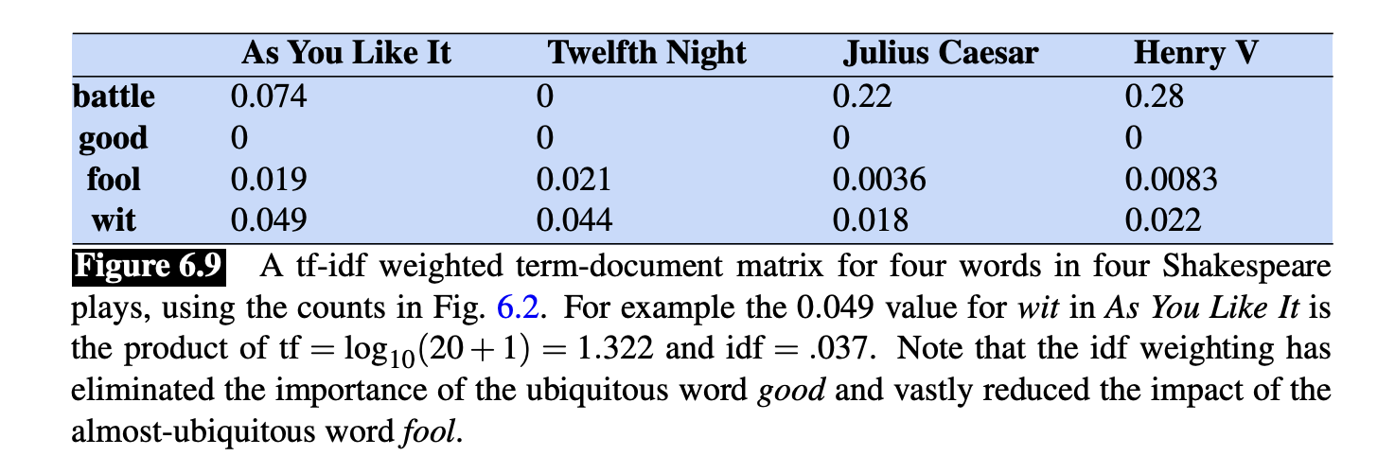
Tf-idf term matrix
Here are some idf values for some words in the Shakespeare corpus:
(There are 37 Shakespeare plays.)

Slide 52
embeddings

Slide 53
Sparse versus dense vectors
tf-idf vectors are
long (length |V|= 20,000 to 50,000)
sparse (most elements are zero)
Alternative: learn vectors which are
short (length 50-1000)
dense (most elements are non-zero)

Slide 54
Sparse versus dense vectors
Why dense vectors?
Short vectors may be easier to use as features in machine learning (fewer weights to tune)
Dense vectors may generalize better than explicit counts
Dense vectors may do better at capturing synonymy:
car and automobile are synonyms; but are distinct dimensions
In practice, they work better

Slide 55
Common methods for getting short dense vectors
“Neural Language Model”-inspired models
Word2vec (skipgram, CBOW), GloVe
Singular Value Decomposition (SVD)
A special case of this is called LSA – Latent Semantic Analysis
Alternative to these "static embeddings":
Contextual Embeddings (ELMo, BERT)
Compute distinct embeddings for a word in its context
Separate embeddings for each token of a word

Slide 56
Simple static embeddings
You can download
Word2vec (Mikolov et al)
https://code.google.com/archive/p/word2vec/
GloVe (Pennington, Socher, Manning)
http://nlp.stanford.edu/projects/glove/

Slide 57
Word2vec
Popular embedding method
Very fast to train
Code available on the web
Idea: predict rather than count
Word2vec provides various options. We'll do:
skip-gram with negative sampling (SGNS)

Slide 58
Word2vec
Instead of counting how often each word w occurs near "apricot"
Train a classifier on a binary prediction task:
Is w likely to show up near "apricot"?
We don’t actually care about this task
But we'll take the learned classifier weights as the word embeddings
Big idea: self-supervision:
A word c that occurs near apricot in the corpus casts as the gold "correct answer" for supervised learning
No need for human labels
Bengio et al. (2003); Collobert et al. (2011)

Slide 59
Approach: predict if candidate word c is a "neighbor"
Treat the target word t and a neighboring context word c as positive examples.
Randomly sample other words in the lexicon to get negative examples
Use logistic regression to train a classifier to distinguish those two cases
Use the learned weights as the embeddings

Slide 60
Skip-Gram Training Data
(assuming a +/- 2 word window)
…lemon, a [tablespoon of apricot jam, a] pinch…
c1 c2 [target] c3 c4
Goal: train a classifier that is given a candidate (word, context) pair
(apricot, jam)
(apricot, aardvark)
…
And assigns each pair a probability:
P(+|w, c)
P(−|w, c) = 1 − P(+|w, c)

Slide 61
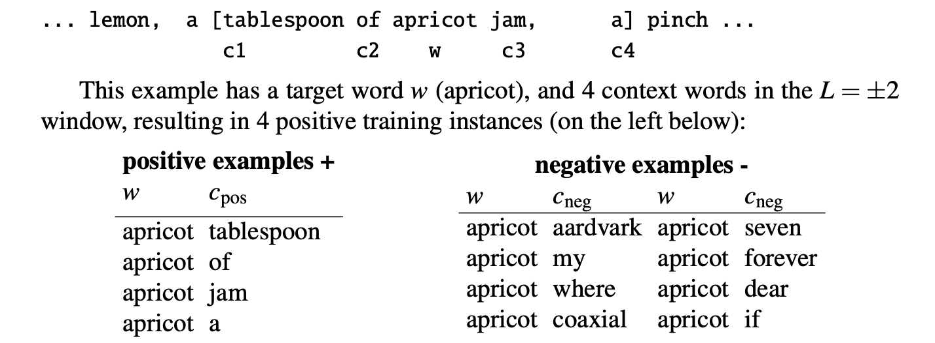
Examples: positive and neagtive

Slide 62
Skip-Gram Classifier
Our goal is to train a classifier such that, given a tuple (w,c) of a target word w paired with a candidate context word c
for example (apricot, jam), or perhaps (apricot, aardvark))
it will return the probability that c is a real context word (true for jam, false for aardvark):
The probability that word c is not a real context word for w is just 1 minus

Slide 63
Similarity is computed from dot product
Remember: two vectors are similar if they have a high dot product
Cosine is just a normalized dot product
So:
Similarity(w,c) ∝ w ∙ c
We’ll need to normalize to get a probability
(cosine isn't a probability either)

Slide 64
Turning dot products into probabilities
Sim(w,c) ≈ w ∙ c
To turn this into a probability
We'll use the sigmoid from logistic regression:

Slide 65
Skip-Gram Classifier
For one context word
For lots of context words
assume independence and just multiply them:

Slide 66
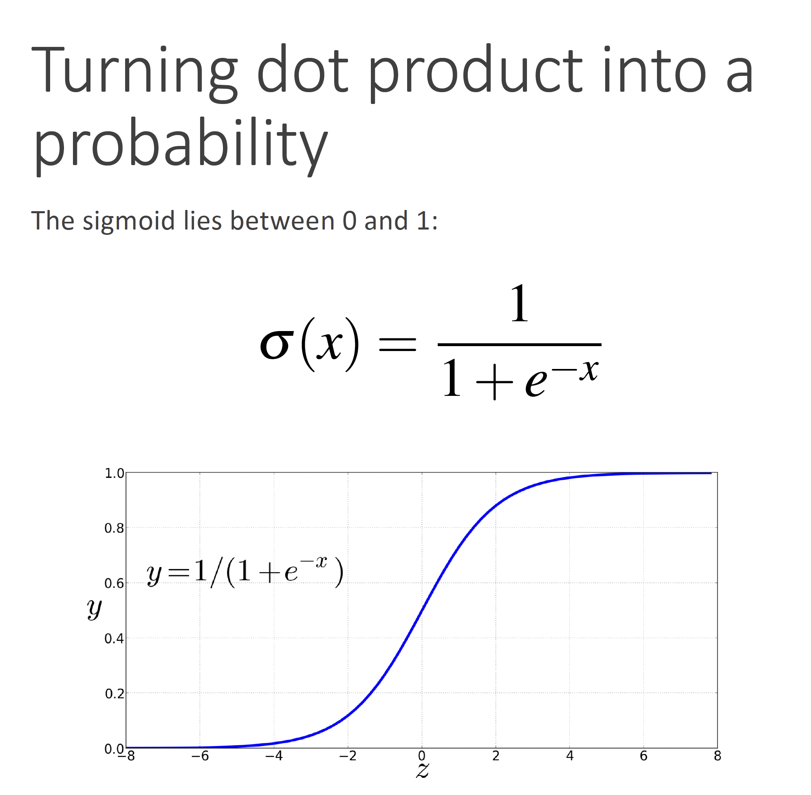

Slide 67
Skip-Gram Classifier
A probabilistic classifier, given
a test target word w
its context window of L words c_{1:L}
Estimates probability that w occurs in this window based on similarity of w (embeddings) to c_{1:L} (embeddings).
To compute this, we just need embeddings for all the words.

Slide 68
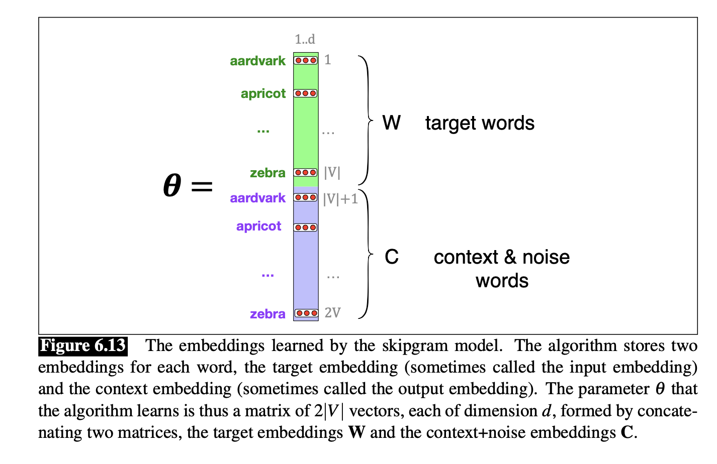
The embeddings learned by the skipgram model.

Slide 69
Skip-Gram Training data
For each positive example, grab k negative examples:

Slide 70
Word2vec: how to learn vectors
Given the set of positive and negative training instances, and an initial set of embedding vectors
The goal of learning is to adjust those word vectors such that we:
Maximize the similarity of the target word, context word pairs (w , c_{pos}) drawn from the positive data
Minimize the similarity of the (w , c_{neg}) pairs drawn from the negative data.

Slide 71
Learning the classifier
How to learn?
Stochastic gradient descent!
We’ll adjust the word weights to
make the positive pairs more likely
and the negative pairs less likely,
over the entire training set.

Slide 72
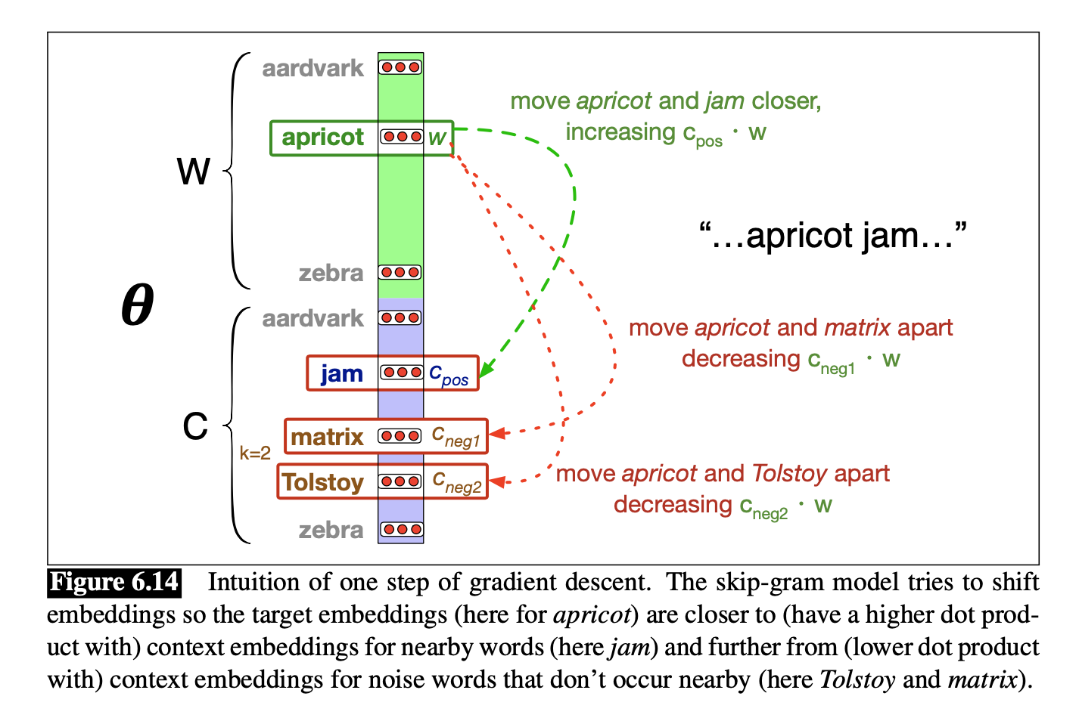
Intuition of one step of gradient descent

Slide 73
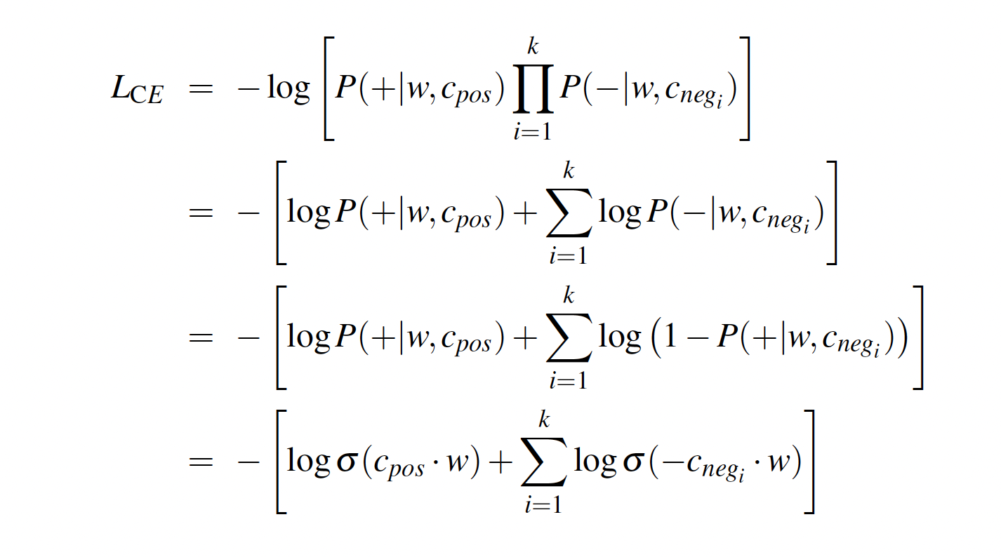
Loss function

Slide 74
Two sets of embeddings
SGNS (Skip-gram with negative samplings)
learns two sets of embeddings
Target embeddings matrix W
Context embedding matrix C
It's common to just add them together, representing word i as the vector w_{i} + c_{i}

Slide 75
How to learn word2vec (skip-gram) embeddings
Start with V random d-dimensional vectors as initial embeddings
Train a classifier based on embedding similarity
Take a corpus and take pairs of words that co-occur as positive examples
Take pairs of words that don't co-occur as negative examples
Train the classifier to distinguish these by slowly adjusting all the embeddings to improve the classifier performance
Throw away the classifier code and keep the embeddings.

Slide 76
The kinds of neighbors depend on window size
Small windows (C= +/- 2) : nearest words are syntactically similar words in same taxonomy
Hogwarts nearest neighbors are other fictional schools
Sunnydale, Evernight, Blandings
Large windows (C= +/- 5) : nearest words are related words in same semantic field
Hogwarts nearest neighbors are Harry Potter world:
Dumbledore, half-blood, Malfoy

Slide 77
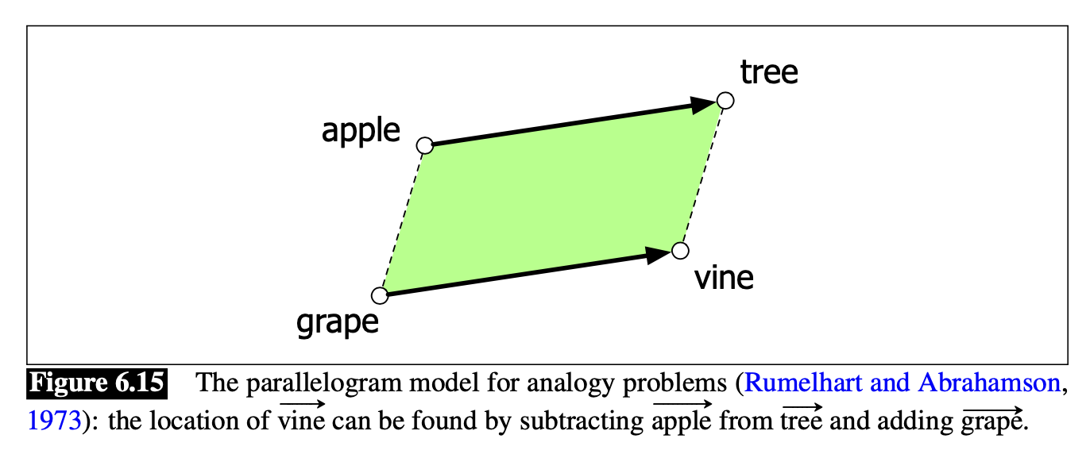
Analogical relations
The classic parallelogram model of analogical reasoning
(Rumelhart and Abrahamson 1973)
To solve: "apple is to tree as grape is to Add tree – apple to grape to get vine

Slide 78
Analogical relations via parallelogram
The parallelogram method can solve analogies with both sparse and dense embeddings
(Turney and Littman 2005, Mikolov et al. 2013b)

Slide 79
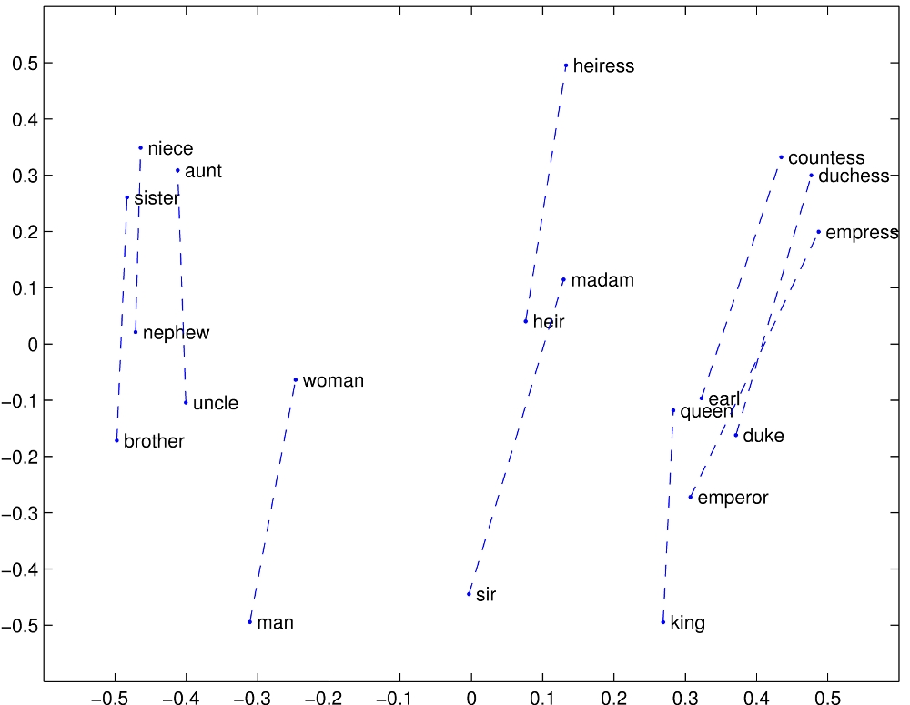

Slide 80
Caveats with the parallelogram method
It only seems to work for frequent words, small distances and certain relations (relating countries to capitals, or parts of speech), but not others.
(Linzen 2016, Gladkova et al. 2016, Ethayarajh et al. 2019a)
Understanding analogy is an open area of research
(Peterson et al. 2020)

Slide 81
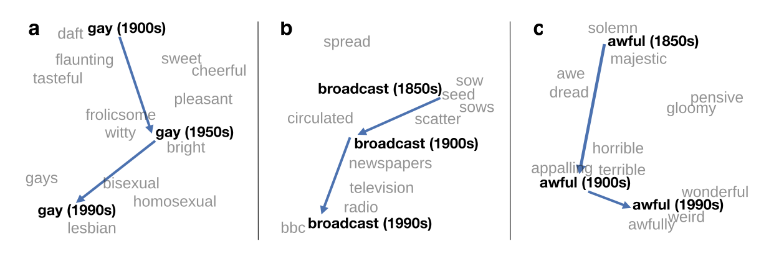
Embeddings as a window onto historical semantics
Train embeddings on different decades of historical text to see meanings shift

Slide 82
Embeddings reflect cultural bias!
Ask “Paris : France :: Tokyo : x”
x = Japan
Ask “father : doctor :: mother : x”
x = nurse
Ask “man : computer programmer :: woman : x”
x = homemaker
Algorithms that use embeddings as part of e.g., hiring searches for programmers, might lead to bias in hiring

Slide 83
Historical embedding as a tool to study cultural biases
Compute a gender or ethnic bias for each adjective:
e.g., how much closer the adjective is to "woman" synonyms than "man" synonyms, or names of particular ethnicities
Embeddings for competence adjective (smart, wise, brilliant, resourceful, thoughtful, logical)
are biased toward men, a bias slowly decreasing 1960-1990
Embeddings for dehumanizing adjectives (barbaric, monstrous, bizarre)
were biased toward Asians in the 1930s, bias decreasing over the 20th century.
These match the results of old surveys done in the 1930s

Slide 84
References
Vector Semantics and Embeddings
Chapter 6 in Speech and Language Processing (3rd ed. draft)
https://web.stanford.edu/~jurafsky/slp3/
It is in the “Readings” folder in Files of Canvas

